Slide 1
Extra-curricular activities

Slide 2
Homework club – All years welcome!
Monday, Wednesday & Thursday between 2.55pm to 3.55pm P102
Everyone welcome!
Come along to use the computers or desk area to complete some of your homework in a relaxed atmosphere.
There will be a member of staff to help guide you.

Slide 3
World cinema club- Y7, Y8 and Y9
Monday between 2.55pm to 3.55pm in K001
Open to Y7, Y8 and Y9.
Come experience the world of Humanities through cinema.
Joining the world cinema club will expose you to a varied spectrum of stories and people's real-world experiences, whilst helping you learn information relevant to topics studied in lessons.

Slide 4
SEND Homework Club- Year 7, 8 & 9
Mondays and Thursdays between 2.55pm to 3.55pm in A113
Open to all Year 7, 8 & 9 students
Teachers and teaching assistants available to support students in completing homework
Literacy and numeracy materials available to support learning
Access to technology

Slide 5
Football- Open to all
Monday between 2.55pm to 3.55pm
Boys football club, open to all
Boys have matches on alternate Wednesdays (see the PE dept for details)
Girls football club is run by Norwich City FC, numbers are currently limited to 25, but will be open to all in January
Full TCA PE kit, shin pads and boots needed

Slide 6
Puzzles Club (Yr 7 & 8)
Monday between 2.55pm to 3.55pm in M002 by Miss A Rose
Solving problems is a skill that is used in everyday life. Joining the maths puzzle club will enable students to develop these skills in a fun and enjoyable way. Students will have access to a wide range of mathematical puzzles and games and through these will gain the skills of resilience and both independent and team working as they will be able to collaborate with others.

Slide 7
Netball
Wednesday between 2.55pm to 3.55pm
Netball club, open to all
Girls have matches on alternate Wednesdays (see the PE dept for details)
Turn up to the changing rooms to sign up!
Full TCA PE kit needed

Slide 8
Carnegie Book Club – Year 9 and 10
Wednesday between 2.55pm to 3.55pm in P009 with Mrs Chilvers
Do you love reading?
Do you want a place to read and discuss exciting new releases?
Are you looking to become a writer or journalist in the future?
Carnegie book club is the club for you!
We will start by reading one of last year's short list, 'Run Rebel' by Manjeet Mann.
Once the short list is announced, we will select a book to read and shadow as a group and attempt to read the others.
What the reviews said:
"This amazing verse novel jangled my nerves so much that I couldn’t read this at bed time. Amber is a totally believable character, as are all the others, and it’s impossible to read this without completely giving your heart to it. The ending is filled with optimism, not just for Amber, but for her mother and sister too, and I love that there are good endings for the women in this story – but it’s a difficult journey.
Beautifully written, perfect for fans of Elizabeth Acevedo."

Slide 9
The Creative Alliance KS3 Fine Art Club
Wednesday between 2.55pm to 3.55pm in P202

Slide 10
SCIENCE CLUB for year 7
Wednesdays between 2:55 and 3:55pm in room K108 with Miss Kay
Science Club is a fun and interactive way to practice your science skills!
You can learn new and interesting facts about how and why things are the way they are.
You will be a hands-on scientist exploring cool science ideas and get to do cool experiments.

Slide 11
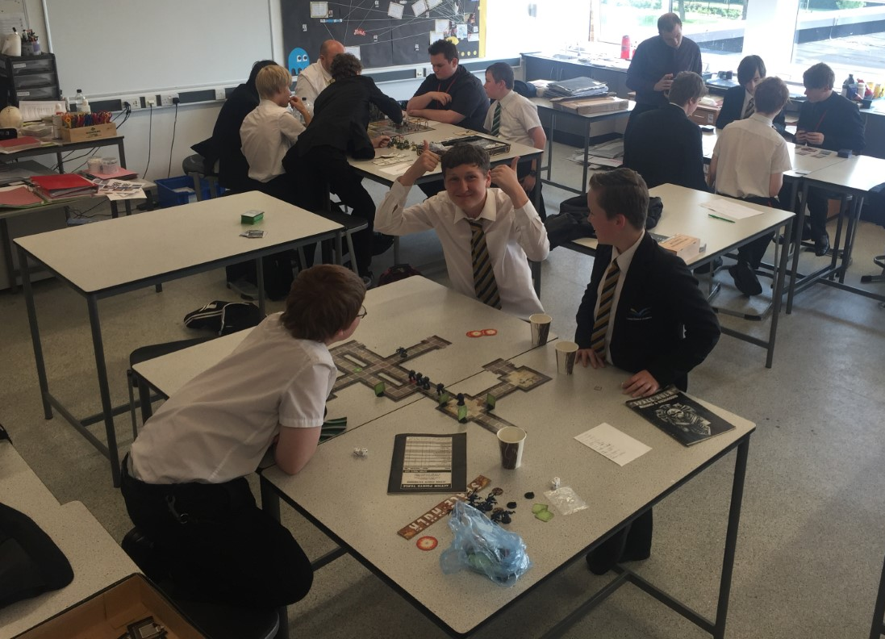
A fantasy board game club.
We play games such as:-
Magic: The Gathering.
Warhammer Fantasy Role-play.
Catan.
Games Workshop.
D&D
Mystic wood
Heroquest
e.t.c.
If you are interested, please speak to Mr Birch.
Spaces are limited
Fantasy, Fun, Peril and Goblins!

Slide 12
Drama Club – All years welcome!
Wednesday between 14:55pm to 16:00pm P114
Everyone welcome!
Join us as we explore Drama and Theatre through a variety of methods, including games and script work. Build confidence and communication skills in a safe environment.

Slide 14
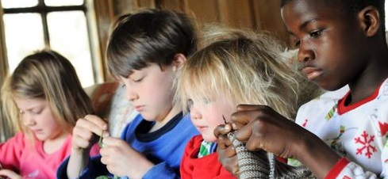
‘Lean to Knit’ Club
Always wanted to knit your own woolly hat (for example)?
Keen on just learning a new skill or to find a relaxing activity which you can do while chatting with friends?
Thursday Lunch time (From 13:10 to 13:55)
In M001
Everyone is welcome.

Slide 15
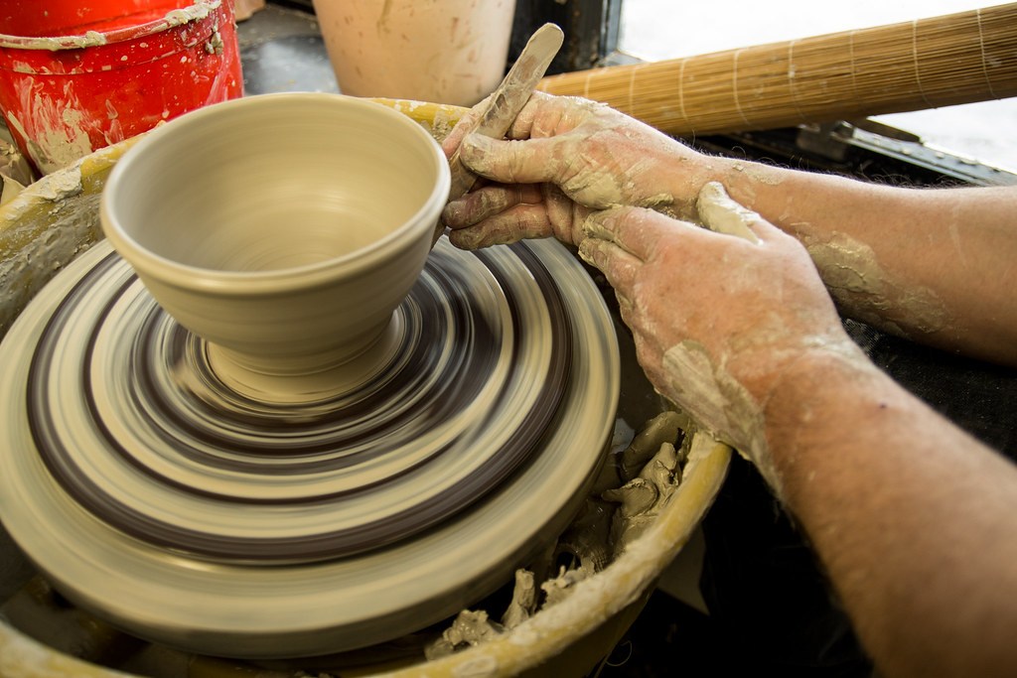
Pottery Throwdown - Year 9
Thursday between 2.55pm to 3.55pm in P205 with Mrs Loosemore
Come along to P205 and learn how to throw a pot on the potter's wheel
This will develop your handling skills with clay as well as developing your confidence using this material.
It will also be lots of fun !!
Limited Spaces available

Slide 16
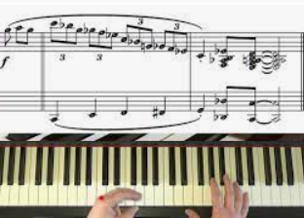
Music Club KS3
Thursday between 2.55pm to 3.55pm in P112 with Mr Winfield
Come along to P112 and develop your musical skills on vocals, keyboards, guitars and percussion instruments as well as your own instruments.
You will also have the opportunity to develop your Musical Technology skills on GarageBand and Bandlab and learn how to record your first album.
Limited Spaces available!!

Slide 17
Eco Schools- All welcome
Thursday between 2.55pm to 3.55pm in K007 with Miss Buckley
How can we make our school more environmentally friendly? Want to be part of creating an eco-garden in our school grounds?
Come along to K007 be a part of TCA’s new eco-committee which work towards helping the school achieve internationally recognised green flag status.
You will have the chance to lead environmental projects to improve our school and make a real difference.

Slide 18
KS3 Dodgeball- Yr. 7, 8 and 9
Thursday between 2.55pm to 3.55pm
Open to all year 7, 8, 9
Want to exercise in a fun and competitive way – dodgeball might be the club for you!
Turn up to the changing rooms, get changed and come to the sports hall!
Full TCA PE kit needed

Slide 19
Music Club KS4
Thursday between 2.55pm to 3.55pm in P113 with Mr McCoy
Come along to P113 and develop your musical skills on vocals, keyboards, guitars and percussion instruments as well as your own instruments.
You can also continue to develop your Musical Technology skills on GarageBand and Bandlab and continue to record your first album.
Practice rooms available for individual practice.
Limited Spaces available!!

Slide 20
6th Form Book Club
Thursday – 8pm via Teams.
The unforgettable, inspiring story of a teenage girl growing up in a rural Nigerian village who longs to get an education so that she can find her “louding voice” and speak up for herself, The Girl with the Louding Voice is a simultaneously heartbreaking and triumphant tale about the power of fighting for your dreams.

Slide 21
Employability skills- A-levels
Wednesday between 2.55pm to 3.55pm in K103 with Miss I Robinson
Join me to work on developing CV’s, covering letters, application forms and interviewing skills. Learning and enhancing employability skills and essential skills for work and higher education.

Slide 22
Genders & Sexualities Alliance – All years welcome!
Friday lunchtime between 13:25pm to 13.50pm P114
Everyone welcome!
A safe space for all pupils, regardless of gender or sexuality, where they can discuss any issues that may be affecting them. As a group, we also discuss key issues surrounding TCA and how we can improve them.

